Slide 1
TOWARDS A Finite model theory for higher-order program verification
Dimitrios Vytiniotis, Koen Claessen,
Simon Peyton Jones, Dan Rosén
WG2.8 – Annapolis, MD, November 2012

Slide 2
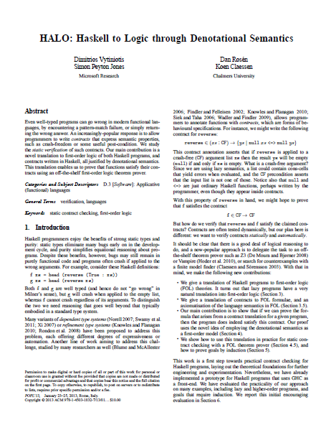
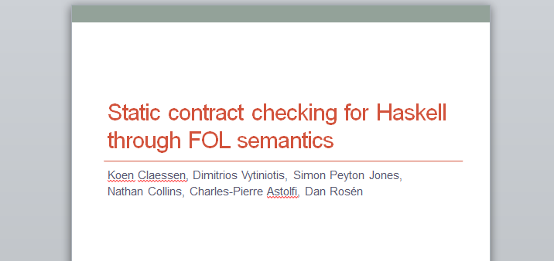
The problem: verify Haskell programs
Automatic verification of easy
properties, but many of those
D.V. @ last WG 2.8 meeting
www.github.com/danr/contracts
POPL 2013
Tool works on subset of Haskell,
uses GHC as frontend

Slide 3
Programs and properties
risers [] = []
risers [x] = [[x]]
risers (x:y:ys)
= case risers (y:ys) of
[] -> error “urk”
(s:ss) -> if x <= y then (x:s):ss
else [x]:s:ss
Can this code crash?
non-empty input ⟶ non-empty result?
risers $?∈$ CF && {xs | not (null xs)} ->
CF && {ys | not (null ys)}
Syntax of “contracts” (“refinements” more appropriate):
C ::= {x | p} | (x:C) -> C | C && C | CF
Just a Haskell expression of type Bool
“crash-free”
(will ignore today)

Slide 4
Design
module Foo
f x y = …
g x = …
HALO
translation to First Order Logic
$$T_{def}$$
First Order Logic
Formulae
g $∉$ C
$$φ_{neg}$$
-- Prelude
data [a] = [] | a : as
data Bool = True | False
… Functions over these…
$$T_{prelude}$$
Haskell
Source
Theorem Prover
Z3/Equinox/E/
Vampire/Paradox
Unsatisfiable ☺
Contract holds!
<loop>
Can’t tell anything
Satisfiable ☹
Probably contract doesn’t hold but who knows

Slide 5
Function definitions become FOL axioms
head (Cons x xs) = x
head _ = error
NB: Will only consider top-level case/λ
$$∀x xs. head\left(Cons\left(x,xs\right)\right)=x$$
$$head\left(Nil\right)=bad$$
$$head\left(bad\right)=bad$$
$$∀y. y=bad∨y=Nil∨$$
$y=Cons\left(selCons_{0}\left(y\right),selCons_{1}\left(y\right)\right)∨$
$head\left(y\right)=unr$
Theory $T_{def}$
Theorem: $D_{∞}⊨T_{def}$
Key insight: standard denotational model, used as a FOL structure!

Slide 6
Axiomatize (some) true facts about $D_{∞}$
data List a
= Cons a (List a)| Nil
$$∀x xs. Cons\left(x,xs\right)≠Nil≠bad≠unr$$
$$∀x xs. selCons_{0}\left(Cons\left(x,xs\right)\right)=x$$
$$∀x xs. selCons_{1}\left(Cons\left(x,xs\right)\right)=xs$$
Theory $T$
Theorem: $D_{∞}⊨T$

Slide 7
Higher-order functions
head (Cons x xs) = x
head _ = error
$$∀x xs. app(head_{ptr},x) =head(x)$$
Interpreted as the apply(.,.) combinator in $D_{∞}$
double f x = f (f x)
$$∀x y. app\left(app\left(double_{ptr},x\right),y\right)= double\left(x,y\right)$$
$$∀x y. double\left(x,y\right)=app(x, app\left(x,y\right))$$

Slide 8
Contracts denotationally and logically
Denotationally
Logically
$e∈\left\{x\right|p\}$ ≙ $e=unr∨p\left[e\right]=unr∨p\left[e\right]=True$
$e∉\left\{x\right|p\}$ ≙ $e≠unr ∧p\left[e\right]≠unr∧ p\left[e\right]≠True$
$e∈\left(x:C_{1}\right)→C_{2}$ ≙ $∀x. \left(x∉C_{1}\right)∨\left(e x∈C_{2}\right)$
$e∉\left(x:C_{1}\right)→C_{2}$ ≙ $∃x. \left(x∈C_{1}\right)∨\left(e x∉C_{2}\right)$

Slide 9
Soundness via denotational semantics
Assume that:
$$UNSAT(T∧T_{def}∧\left(f∉C\right))$$
Then:
$$T∧T_{def}⊢(f∈C)$$
By previous theorems:
$$D_{∞}⊨T∧T_{def}$$
… hence:
$$D_{∞}⊨\left(f∈C\right)$$
… which is equivalent to:
$$⟦f⟧ ∈⟦C⟧$$
☺

Slide 10
Happy
Z3 rocks for provable contracts!
Disclaimer:
40-80 FOL axioms/problem
Use of fixpoint induction; not going to talk about it today

Slide 11
Happy?
Here is what happens for unprovable properties
Paradox Equinox Z3 Vampire E-prover
AnyMorphism.big_sat_app_any_morphism_fail_step P:---- X:---- Z:---- V:---- E:----
Loop.sat_id_loop_pred P:0.00 X:0.01 Z:0.01 V:---- E:0.01
Loop.sat_id_recursive_true P:---- X:---- Z:---- V:---- E:0.01
PredLog.sat_concatMap_cf_missing_step P:---- X:---- Z:---- V:---- E:----
PredLog.sat_concatMap_retains_missing_step P:---- X:---- Z:---- V:---- E:----
PredLog.sat_flattenAnd_cf_missing_step P:---- X:---- Z:---- V:---- E:----
PredLog.sat_flattenAnd_retains_missing_step P:---- X:---- Z:---- V:---- E:----
Recursion.big_sat_exp_accum_cf_broken_step P:---- X:---- Z:---- V:---- E:----
Recursion.sat_exp_cf_broken_step P:---- X:---- Z:---- V:---- E:----
Recursion.sat_fac_cf_broken_step P:---- X:---- Z:---- V:---- E:----
Recursion.sat_mul_cf_broken_step P:---- X:---- Z:---- V:---- E:----
Recursion.sat_mult_cf_broken_step P:---- X:---- Z:---- V:---- E:----
Recursion.sat_qfac_cf_broken_step P:---- X:---- Z:---- V:---- E:----
Recursion.sat_rev_cf_broken_step P:---- X:---- Z:---- V:---- E:----
Risers.big_sat_risersBy_nonEmpty_broken2_step P:---- X:---- Z:---- V:---- E:----
Risers.big_sat_risersBy_nonEmpty_broken_step P:---- X:---- Z:---- V:---- E:----
Risers.sat_risers_broken2_step P:---- X:---- Z:---- V:---- E:----
Risers.sat_risers_broken3_step P:---- X:---- Z:---- V:---- E:----
Risers.sat_risers_broken_step P:---- X:---- Z:---- V:---- E:----
Risers.sat_risers_missing_le_step P:---- X:---- Z:---- V:---- E:----
Shrink.big_sat_shrink_lazy_step P:---- X:---- Z:---- V:---- E:----
Timeouts …
☹

Slide 12
The reason: loss of finite models
(1) $∀x. S\left(x\right)≠Z$
(2) $∀x. selS_{0}\left(S\left(x\right)\right)=x$
Consider any model $M$ and a program that uses $Z$ and
$$M⊨T∧T_{def}∧\left(f∉C\right)$$
Z $∈M$
(1) =/=
(1) =/=
S(Z)
(2) =/=
S(S(Z))
etc.
There must be an infinite number of
elements in the model: Z, S(Z), S(S(Z)),…

Slide 13
Loss of finite models is bad
Theorem prover loops trying to construct an infinite model
User never gets to see a counterexample – be it a real counterexample or a result of incompleteness
Even if the counterexample is dead-simple
length [] = Z
length (x:xs) = S (length xs)
isZero Z = True
isZero _ = False
length ∈ CF → {x | isZero x}
[Z] … duh!

Slide 14
Two (fine) ways out of this situation
Roll-your-own
decision procedures
(e.g. Leon)
Modify translation
to FOL (e.g. Nitpick)
Our choice: let’s try to re-use existing technology

Slide 15
The ideal modified translation
Sound
$$UNSAT\left(T^{M}∧T_{def}^{M}∧{\left(f∉C\right)}^{M}\right)$$
implies $UNSAT\left(T∧T_{def}^{}∧(f∉C)\right)$
Has the finite model property
If $⟦f⟧∉⟦C⟧$ (or weaker) then there exists finite M, $M⊨T^{M}∧T_{def}^{M}∧{\left(f∉C\right)}^{M}$
Complete (i.e. doesn’t introduce more fake counterexamples)
$UNSAT\left(T∧T_{def}^{}∧(f∉C)\right)$
implies $UNSAT\left(T^{M}∧T_{def}^{M}∧{\left(f∉C\right)}^{M}\right)$

Slide 16
The quest for ${\left(∗\right)}^{M}$ …

Slide 17
What is a counterexample?
Assume: $⟦e⟧∉⟦\left\{y \right| p\}⟧$
By adequacy: $e⇓v$ and $p\left[e\right]⇓False$
A bunch of finite evaluation traces!
Key intuition: try to capture “minimal core” of the terms and function behaviors that are involved in a counterexample trace

Slide 18
When a term does not satisfy its spec
Previously
$e∈\left\{x\right|p\}$ ≙ $…$
$e∉\left\{x\right|p\}$ ≙ $e≠unr ∧p\left[e\right]≠unr∧ p\left[e\right]≠True$
$e∈\left(x:C_{1}\right)→C_{2}$ ≙ …
$e∉\left(x:C_{1}\right)→C_{2}$ ≙ …
Modified translation
${\left(e∈\left\{x | p\right\}\right)}^{M}$ ≙ $…$
${\left(e∉\left\{x | p\right\}\right)}^{M}$ ≙ $min\left(e\right)∧min⁡(p\left(e\right))∧$
$e≠unr ∧p\left[e\right]≠unr∧ p\left[e\right]≠True$
${\left(e∈\left(x:C_{1}\right)→C_{2}\right)}^{M}$ ≙ …
${\left(e∉\left(x:C_{1}\right)→C_{2}\right)}^{M}$ ≙ …

Slide 19
An example
length ∈ CF → {x | isZero x}
Counterexample:
$length\left(\left[Z\right]\right)⇓S(Z)$ $isZero\left(S\left(Z\right)\right)⇓False$
Key intuition: Any counter-trace must contain terms:
length x
isZero (length x)
Ask for a model of
$$T^{M}∧T_{def}^{M}∧$$
$$\min\left(length\left(x\right)\right)∧$$
$$min⁡(isZero\left(length\left(x\right)\right))∧$$
$$length\left(x\right)≠unr∧isZero\left(length\left(x\right)\right)≠True$$

Slide 20
Propagation of min
If a strict function application is in a trace, then so must be its argument!
head (Cons x xs) = x
head _ = error
$$∀x y xs.\min\left(head\left(y\right)\right)⇒\min\left(y\right)$$
∧ $y=Cons\left(x,xs\right)⇒head\left(y\right)=x$
∧ $y=Nil⇒head\left(y\right)=bad$
∧ $y=bad⇒head\left(y\right)=bad$
∧ $(y=bad∨y=Nil∨$
$y=Cons\left(selCons_{0}\left(y\right),selCons_{1}\left(y\right)\right)∨$
$head\left(y\right)=unr)$
Theory $T_{def}^{M}$

Slide 21
A requirement for completeness
Goal:
$UNSAT\left(T∧T_{def}^{}∧(e∉\{y|p\})\right)$
implies
$$UNSAT\left(T^{M}∧T_{def}^{M}∧{\left(e∉\{y|p\}\right)}^{M}\right)$$
Amounts to:
$$T∧T_{def}^{}⊢e=unr ∨p\left(e\right)=\{unr,True\}$$
implies
$$T^{M}∧T_{def}^{M}⊢\min\left(e\right)∧\min\left(p\left(e\right)\right)⇒$$
$e=unr∨p\left(e\right)=\{unr,True\}$

Slide 22
Completeness guides $T^{M}$ design
Lemma A:
If $T∧T_{def}^{}⊢e=True$ then $T^{M}∧T_{def}^{M}⊢\min\left(e\right)⇒e=True$
Proof
Proof theoretically ☹
Model theoretically ☹
By adequacy and induction on the evaluation of “e”! ☺
More interestingly, it tells us how to modify theory $T^{M}$
data List a
= Cons a (List a)| Nil
$$∀x xs. Cons\left(x,xs\right)≠Nil≠bad≠unr$$
$$∀x xs.\min\left(Cons\left(x,xs\right)\right)⇒selCons_{0}\left(Cons\left(x,xs\right)\right)=x$$
$$∀x xs.\min\left(Cons\left(x,xs\right)\right)⇒selCons_{1}\left(Cons\left(x,xs\right)\right)=xs$$

Slide 23
Provable bottoms and completeness
Lemma B:
If $T∧T_{def}^{}⊢e=unr$ then $T^{M}∧T_{def}^{M}⊢\min\left(e\right)⇒e=unr$
The adequacy + induction trick does not work any more! No finite number of steps until non-termination ☺
f x = f (S x)
Fortunately:
If $e⇑$ then $T∧T_{def}^{} ∧e=unr$ has a model but so does $T∧T_{def}^{} ∧e=bad$!
In simple words, if we ever prove that $e=unr$ it must be the case that $e$ just gets “stuck” after a finite number of steps, not that it diverges! So, the same technique as Lemma A can prove Lemma B!

Slide 24
Finite models
Given a counter-trace, need to construct finite model:
$$M⊨T^{M}∧T_{def}^{M}$$
$$M⊨\min\left(length\left(x\right)\right)∧\min\left(isZero\left(length\left(x\right)\right)\right)$$
$$M⊨length\left(x\right)≠unr∧isZero\left(length\left(x\right)\right)≠True$$

Slide 25
Constructing finite models from traces
$$\frac{ \frac{\left[f(Z)\right]⇓\left[f(Z)\right] length\left(\left[ \right]\right) ⇓ Z}{length\left(\left[f(Z)\right]\right) ⇓ S(Z)} isZero\left(S\left(Z\right)\right) ⇓ False}{isZero(length\left(\left[f(Z)\right]\right)⇓False }$$
$6
$4
$5
$3
$1
$2
$1
Construction idea (roughly):
Take all terms that were evaluated (finite) in β-equivalence classes to be in min()
Take all terms that were not equivalent to a term in the first group (also finite) in β-equivalence classes.
Add appropriate function tables.
isZero($2) = $1
length($4) = $2
Cons($6,$5) = $4
Nil = $5
Z = $3
f($3) = $6
S($3) = $2
MIN={$1,$2,$3,$4,$5}

Slide 26
Arrow contracts
Assume $⟦e⟧∈⟦\{y|p\}⟧$ but $⟦f(e)⟧∉⟦\{y|q\}⟧$
So is there a (finite) model for:
$$T^{M}∧T_{def}^{M}∧{\left(x∈\{y|p\}\right)}^{M}∧{\left(f\left(x\right)∉\{y|q\}\right)}^{M}$$
These 2 are fine!
What about that translation!!?

Slide 27
Completeness forces positive translation
${\left(e∈\left\{x | p\right\}\right)}^{M}$ ≙ $\min\left(e\right)∧min⁡(p\left(e\right))∧$
$$(e=unr ∨p\left[e\right]=unr∨ p\left[e\right]=True)$$
${\left(e∉\left\{x | p\right\}\right)}^{M}$ ≙ $min\left(e\right)∧min⁡(p\left(e\right))∧$
$e≠unr ∧p\left[e\right]≠unr∧ p\left[e\right]≠True$
${\left(e∈\left(x:C_{1}\right)→C_{2}\right)}^{M}$ ≙ $∀x. {\left(x∉C_{1}\right)}^{M}∨{\left(e x∈C_{2}\right)}^{M}$
${\left(e∉\left(x:C_{1}\right)→C_{2}\right)}^{M}$ ≙ $∃x. {\left(x∈C_{1}\right)}^{M}∨{\left(e x∉C_{2}\right)}^{M}$
Provably sound and complete wrt unmodified translation

Slide 28
Soundness is for babies!
$$UNSAT\left(T^{M}∧T_{def}^{M}∧{\left(f∉C\right)}^{M}\right)$$
implies $UNSAT\left(T∧T_{def}^{}∧(f∉C)\right)$
… or
$$T^{M}∧T_{def}^{M}⊢¬{\left(f∉C\right)}^{M}$$
implies $T∧T_{def}^{}⊢¬ (f∉C)$
Easy model theoretic argument!

Slide 29
Sadly we lost finite models again …
f x = x
f ∈ CF → {y|p} -- Already proved
g ∈ …
$$∀x.\min\left(f\left(x\right)\right)⇒f\left(x\right)=x$$
$$∀x.\min\left(f\left(x\right)\right)∧…$$
Hence: $∀x. min⁡(x)$ !!!!

Slide 30
Idea: weaken arrow contracts
${\left(e∈\left\{x | p\right\}\right)}^{M}$ ≙ …
${\left(e∉\left\{x | p\right\}\right)}^{M}$ ≙ …
${\left(e∈\left(x:C_{1}\right)→C_{2}\right)}^{M}$ ≙ $∀x.\min\left(e x\right)⇒$
$\left(x∉C_{1}\right)∨\left(e x∈C_{2}\right)$
${\left(e∉\left(x:C_{1}\right)→C_{2}\right)}^{M}$ ≙ $…$
Intuition: only if you are interested in an application can you use information about it
Open: how do finite models get affected?
Tension!
Open: how does
completeness get affected?

Slide 31
Is completeness really lost?
Assume: $f∈CF →\left\{y \right| p\}$
In the unmodified world:
$$f\left(t\right)=unr ∨p\left(f\left(t\right)\right)=\left\{True,unr\right\}⊢φ$$
In the modified world:
$\min\left(f\left(t\right)\right)⇒min⁡(p\left(f\left(t\right)\right)∧$
$(f\left(t\right)=unr ∨p\left(f\left(t\right)\right)=\left\{True,unr\right\}⊢φ^{M}$
If we can derive $⊢min⁡(f\left(t\right))$
then we are good! ☺
If not, then, if p can only assert information about $f\left(t\right)$*, we are also done!
* HANDWAVE ARG WARNING

Slide 32
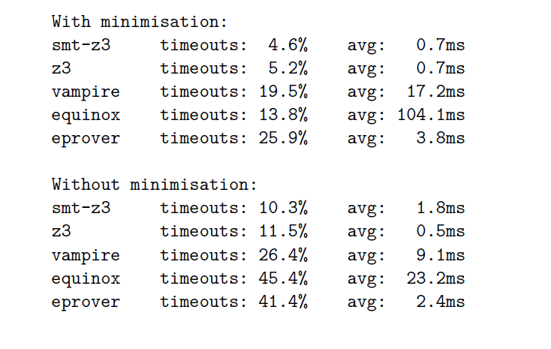
… and does it matter?
All timeouts for SAT problems → ~ a second each
Also helps prove things faster! (except for Z3 magic ☺)

Slide 33
It’s really verification vs. model checking
We are aiming to use the same hammer on two maybe very different problems ….
We design a logic for proving specifications
… which is also good in finding counterexamples!
Is it reasonable to try and reconcile both? Should we be looking at each separately?

Slide 34
Thanks!
$${… \left(∗\right)}^{M} ???$$

Slide 35
Extra material

Slide 36
Key idea: use denotational semantics
$$P∷=\left(f_{1} {\overline{x}}_{1}=u_{1}\right)…\left(f_{n} {\overline{x}}_{n}=u_{n}\right)$$
$$u∷=case e of \overline{p→e} | e$$
$$e∷= x \left| f \right| e e \left| K\left(\overline{e}\right)\right| BAD$$
A λ/case-lifted language
Standard $D_{∞}$ construction
$$D_{∞}≈{\left( Π_{n_{1}}D_{∞}+ …+Π_{n_{k}}D_{∞}+\left(D_{∞}⇒D_{∞}\right)+1_{bad}\right)}_{⊥}$$
Lifting
Continuous
function space
One product of $n_{i}$ cpos for e $n_{i}$ach constructor $K_{i}$ of arity $n_{i}$
Distinguished
one-element cpo

Slide 37
… and use $D_{∞}$ itself as FOL structure
Logical language:
$$t ∷=x∣f_{ptr}∣f\left(\overline{x}\right)∣K\left(\overline{x}\right)∣{selK}_{i}\left(t\right)∣app\left(t_{1},t_{2}\right)∣unr∣bad$$
A translation of expressions to logical terms:
𝓔$⦃x⦄=x$
$$\text{𝓔}⦃e_{1} e_{2}⦄=app\left(\text{𝓔}⦃e_{1}⦄,\text{𝓔}⦃e_{2}⦄\right)$$
$$\text{𝓔}⦃K\left(\overline{e}\right)⦄=K\left(\text{𝓔}⦃\overline{e}⦄\right)$$
𝓔$⦃f⦄=f_{ptr}$
𝓔$⦃BAD⦄=bad$
Interpreted as the ‘apply’
combinator in $D_{∞}$
apply ($1_{bad}$,_) = $1_{bad}$
apply ($⊥$,_) = $⊥$
apply(fun(d),d’) = d(d’)
apply(_,_) = $⊥$
Interpreted as injection into the appropriate product

Slide 38
Question: what about completeness?
${\left(e∈\left\{x | p\right\}\right)}^{M}$ ≙ …
${\left(e∉\left\{x | p\right\}\right)}^{M}$ ≙ …
${\left(e∈\left(x:C_{1}\right)→C_{2}\right)}^{M}$ ≙ $∀x.\min\left(e x\right)⇒\left(x∉C_{1}\right)∨\left(e x∈C_{2}\right)$
${\left(e∉\left(x:C_{1}\right)→C_{2}\right)}^{M}$ ≙ $…$
Assume:
$$f∈CF →\left\{y \right| p\}$$
$$f\left(t\right)=unr ∨p\left(f\left(t\right)\right)=\left\{True,unr\right\}⊢ …$$
For those f(t) that would be called we have all “knowledge”. For those f(t) that /are not called/ the unmodified theory must have been able to prove the goal assuming they were just unr. Oh, what about functions that were both defined and given a contract? Then we are in trouble, when they yield information about some other variable in the closure …

Slide 39
Ask for information on the whole closure?
${\left(e∈\left\{x | p\right\}\right)}^{M}$ ≙ …
${\left(e∉\left\{x | p\right\}\right)}^{M}$ ≙ …
${\left(e∈\left(x:C_{1}\right)→C_{2}\right)}^{M}$ ≙ $∀x.\min\left(e x\right)∨min\left(Δ\right)⇒$
$\left(x∉C_{1}\right)∨\left(e x∈C_{2}\right)$
${\left(e∉\left(x:C_{1}\right)→C_{2}\right)}^{M}$ ≙ $…$

